Slide 1
Team name: EVIL_MORTY
People Counting System for Getting In/Out of a Bus
Based on Video Processing
Link to repo : https://github.com/Digital-Image-Processing-IIITH/dip-project-evil_morty
TEAM MEMBERS
Pulkit Gupta (2019101078, CSE) palash sharma (2019101082, cse)
Archit Jain (2019101053, CSE) Aryan jain (2019101056, CSE)
TA Mentor
Kalyan Adithya

Slide 2
Problem Statement
To implement an automatic system for counting people in a video recorded by zenithal camera in the bus to capture the flow bi-directionally.

Slide 3
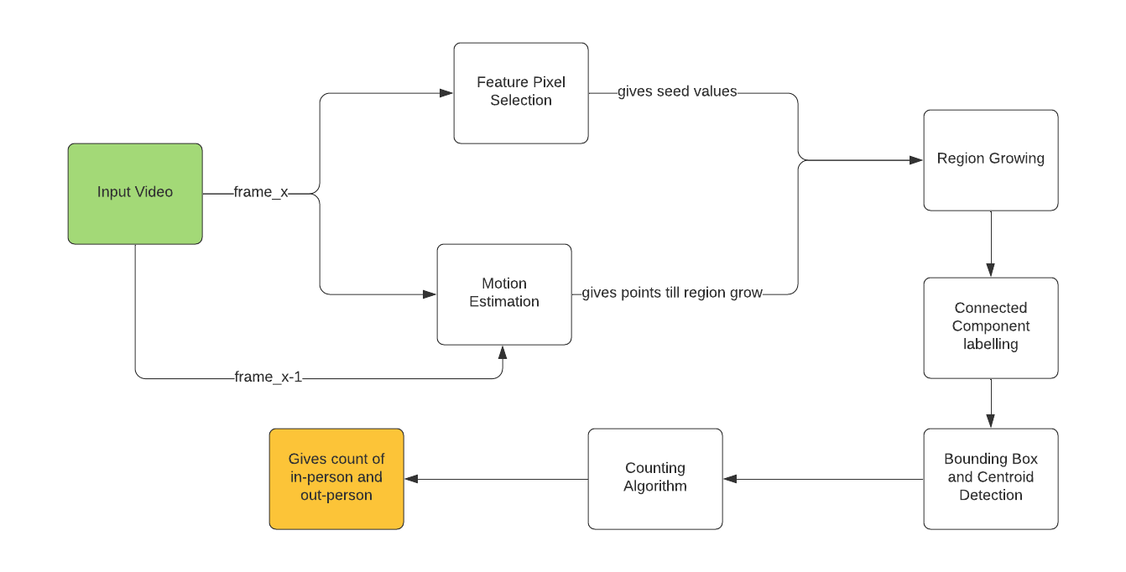
Flow Diagram

Slide 4
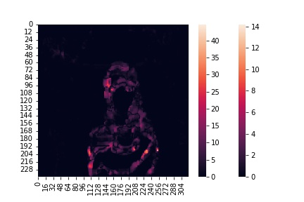
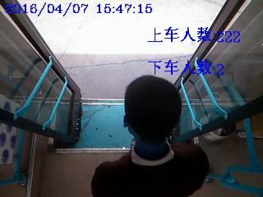
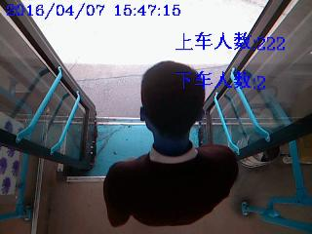
Motion estimation
Calculate optical flow between adjacent frames of the video
Used to differentiate between a moving and stationary object
For identifying moving people
Frame x-1
Frame x
Heatmap of motion vector

Slide 5
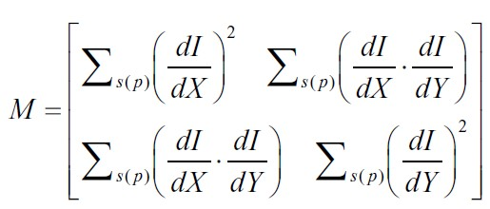
Feature Pixel Selection
Selects most significant feature.
Differential Matrix M is calculated in Neighborhood s(p) 3x3.
Pixels with greater feature value ( R ) are likely located on the moving object.
R = det M – k (trace M)²

Slide 6
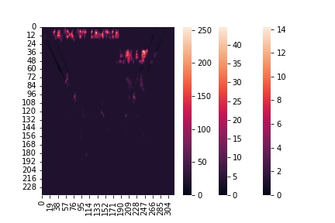
Feature Pixel Selection
Frame x
Heatmap of R score

Slide 7
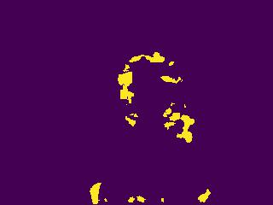
Region Growing
Grouping pixels of moving object using seeds from feature pixel selection.
Used BFS for generation components using eight connection search.
Frame x
After Region Growing

Slide 8

Connected Component Labelling
Used DFS to calculate area of each separated components.
Treated components having area less than a threshold as background.
Later collected nearby components to treat it as one object.
After Region Growing
After Connected Component Labelling

Slide 9
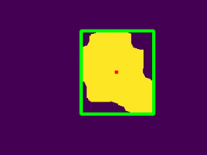
Bounding Box & Centroid Detection
Used BFS to visit all co-ordinates of each connected component and took their average to find the co-ordinate of centroid.
Bounding Box is calculated by taking the minimum/maximum x-y coordinates for each connected component.
After Connected Component Labelling
Bounding Box And Centroid

Slide 10
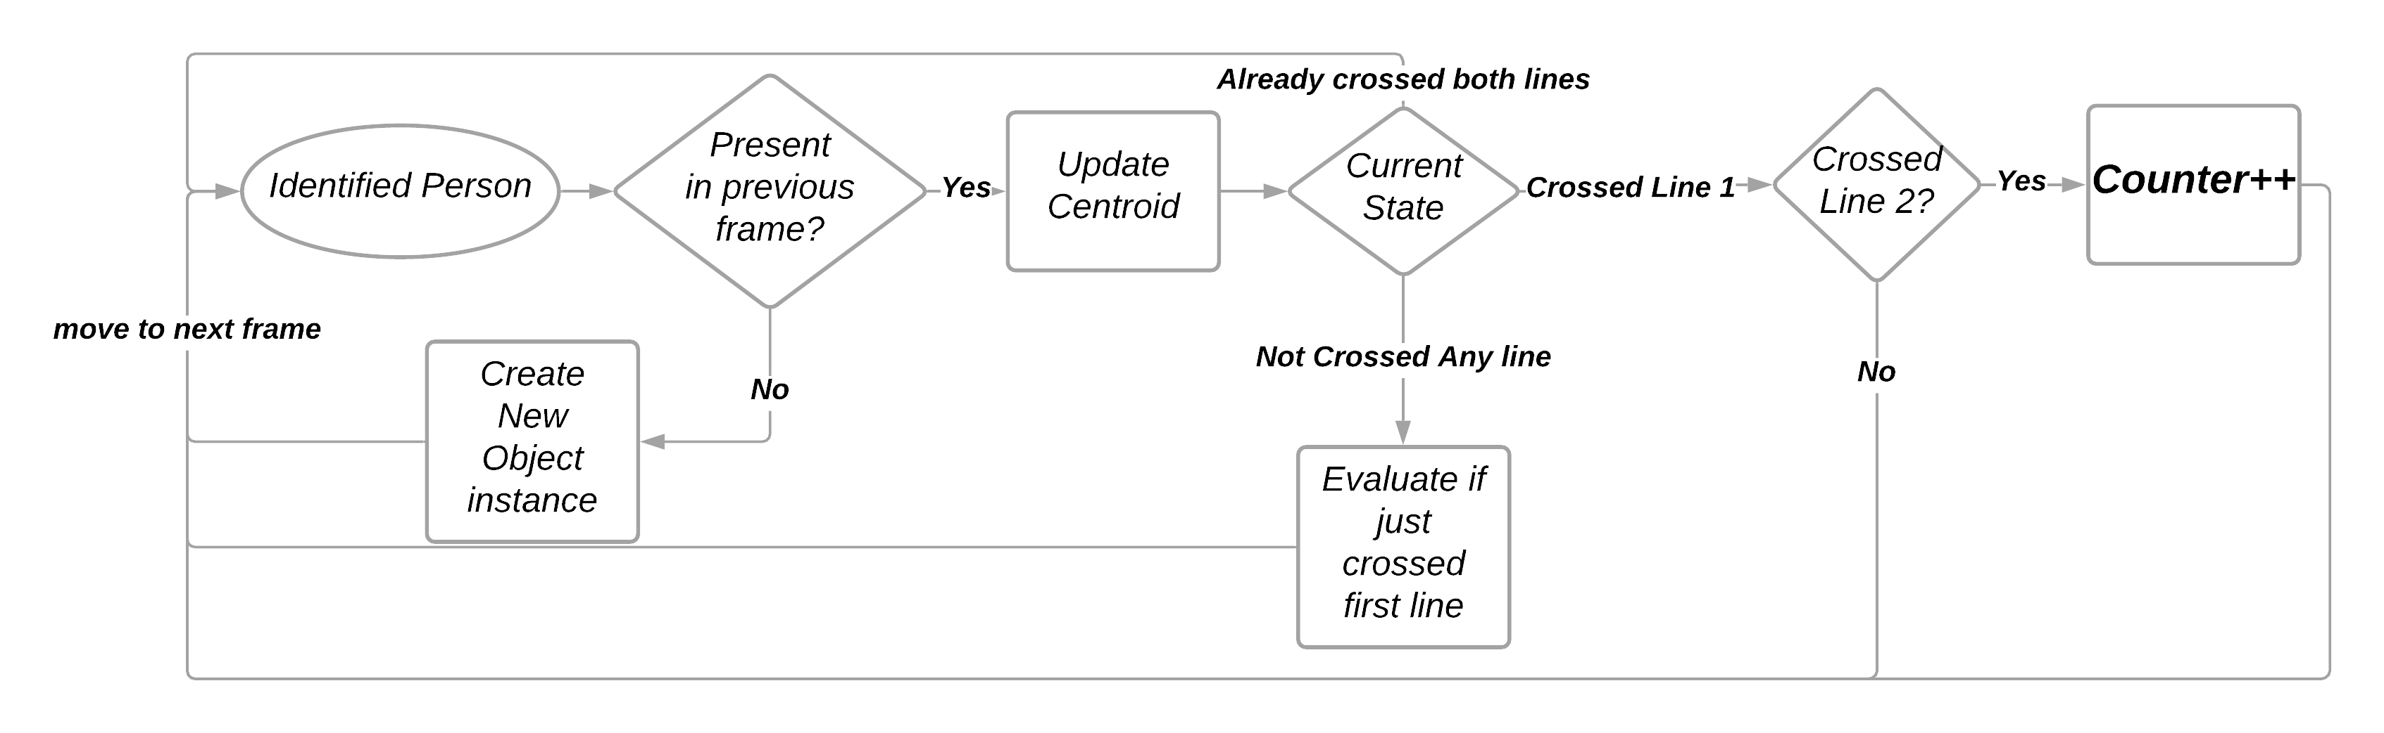
People Counting Algorithm

Slide 11
Evaluation Metric
We are using Accuracy as an evaluation metric to understand how better the algorithm is performing.
Accuracy Formula
1/2*[(Cin/Rin or Rin/Cin) +(Cout/Rout or Rout/Cout)]*100 %

Slide 12
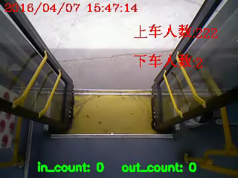
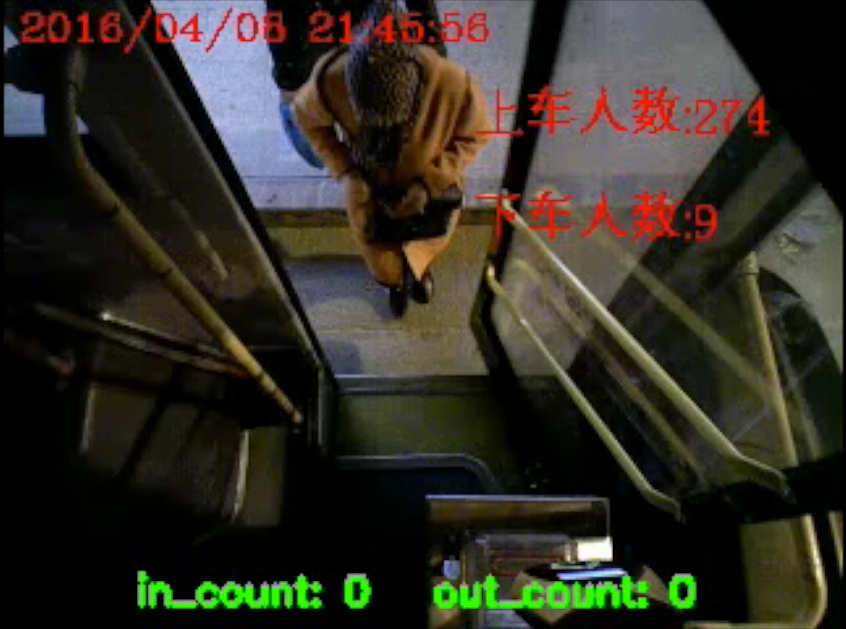
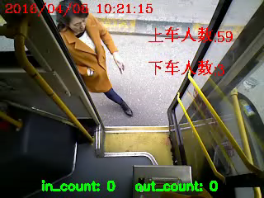
Outputs
Unnoisy + Bright Sunlight
Unnoisy + Night Light
Noisy + Weak Sunlight

Slide 13
Results
Video | Attribute | Real Passengers |  | Counted Passengers |  | Accuracy
 |  | IN | OUT | IN | OUT
Video 1 (40s) | Weak Sunlight | 4 | 0 | 4 | 0 | 100%
Video 2 (22s) | Weak Sunlight | 3 | 1 | 2 | 1 | 83.33%
Video 3 (13s) | Bright Sunlight | 1 | 1 | 1 | 1 | 100%
Video 4 (12s) | Bright Sunlight | 1 | 0 | 1 | 0 | 100%
Video 5 (18s) | Bright Sunlight | 2 | 0 | 2 | 0 | 100%
Video 6 (72s) | Weak Sunlight | 3 | 2 | 3 | 2 | 100%
Video 7 (13s) | Weak Sunlight+ Noisy | 1 | 0 | 1 | 0 | 100%
Video 8(7s) | Night Light | 1 | 0 | 1 | 0 | 100%
Video 9*(14s) | Crowded | 2 | 0 | 1 | 0 | 50%
Final Accuracy |  |  |  |  |  | 92.59%
* Represents limitation

Slide 14
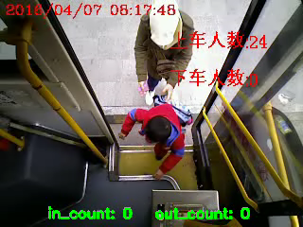
Limitation

Slide 15
Work Division
Pulkit Gupta and Archit Jain
Project planning and Discussion, Video to frames, Feature Pixel Selection, Connected Component labelling, Compiled components of project into single working code, Demo, Documentation and Testing
Palash Sharma and Aryan Jain Project planning and Discussion, Motion Estimation, Region Growing, Counting Algorithm, Centroid detection, Compiled components of project into single working code, Documentation and Testing

Slide 16

Thank You

